Slide 1
Samsung
Innovation
Campus
Coding and Programming

Slide 2
Chapter 5.
Algorithm 2 - Sorting Algorithms
Coding and Programming

Slide 3
Chapter Description
Chapter objectives
Learners can understand sorting problems and solve sorting problems using bubble sort, selection sort, insertion sort, merge sort, and quick sort methods. In addition, the sorting algorithm can be implemented in Python, and learner can understand and compare the time complexity of each sorting method.
Chapter contents
Unit 27. Bubble, Selection, and Insertion Sort
Unit 28. Merge Sort
Unit 29. Quick Sort

Slide 4
Unit 27.
Bubble, Selection, and Insertion Sort

Slide 5
Unit learning objective (1/3)
UNIT 27
Learning objectives
Understand the sorting problem and be able to solve the sorting problem using various sorting techniques.
Understand and be able to explain the differences between bubble sort, selection sort, and insertion sort.
Understand and be able to describe the time complexity of bubble sort, selection sort, and insertion sort.

Slide 6
Unit learning objective (2/3)
UNIT 27
Learning overview
Implement bubble sort, which sorts two adjacent elements by swapping them.
Implement selection sort, which finds the smallest element and creates a sorted list.
Implement insertion sort, which inserts a new element into a sorted list.
Concepts you will need to know from previous units
Using comparison operators to compare two numbers.
Using the swap function to swap the positions of two numbers.
Applying Big O notation to analyze the time complexity of an algorithm.

Slide 7
Unit learning objective (3/3)
UNIT 27
Keywords
Sorting Problem
Bubble Sort
Selection Sort
Insertion Sort
Quadratic Time

Slide 8
Unit 27.
Bubble, Selection, and Insertion Sort
Mission

Slide 9

Mission
UNIT 27
1. Real world problem
1.1. The problem of sorting
In our daily life, we often encounter alignment problems.
Ex
Suppose you are given 5 blue iron marbles as shown below. These iron marbles are the same shape and size but have different weights. What method should be used to sort these iron marbles in ascending order of weight as shown below?
Unsorted
50
30
40
10
20
Sorted
10
20
30
40
50

Slide 10
Mission
UNIT 27
2. Mission
2.1. Bubble sort: when you can swap only two adjacent elements
Imagine that a tool we can use is a device that can do the following:
You can pick up two marbles adjacent to each other and compare their weights.
The two marbles can be put down by swapping positions.
Since the device cannot remember the weight of the marbles, only two adjacent marbles at a time can change their positions. It can use a strategy to send the heavier marble to the right for each comparison.
With this strategy, how many comparisons do all the marbles need to be placed in a sorted order by weight?

Slide 11

Mission
UNIT 27
2. Mission
2.2. Selection sort: when you can use a balance scale
Use a balance scale. The balance scale can do the following operations:
You can pick up two marbles that are not adjacent to each other and compare their weights.
The two marbles can be returned by swapping their positions.
The balance scale also cannot remember the weight of the marble, but it can swap the positions of two marbles that are not adjacent to each other at once. You can choose a strategy to compare the first marble with the least weighted marble so that it can be swapped.
With this strategy, how many comparisons would it take to place all the marbles in sorted order by weight?

Slide 12
Mission
UNIT 27
2. Mission
2.3. Insertion sort: when you can get only a ball at a time
Use the balance scale. This time there are limitations:
The iron marbles are in the barrel, and they can only be taken out one at a time.
Whenever a marble is taken out, it should always be placed in a sorted position.
In this case, it is not possible to compare all the marbles at once, but since there are already sorted marbles each time they are taken out, the new marble can be searched for in sequence.
With this strategy, how many comparisons would it take to place all the marbles in sorted order by weight?
Already Sorted

Slide 13
Unit 27.
Bubble, Selection, and Insertion Sort
Key concept

Slide 14
Key concept
UNIT 27
1. Bubble Sort
1.1. An example of bubble sort
Bubble sort is a sorting algorithm that compares two adjacent elements and swaps their positions if the order is reversed.
Ex
Suppose we want to sort a list arranged in the order of [50, 30, 40, 10, 20] as follows.
50
30
40
10
20

Slide 15
Key concept
UNIT 27
1. Bubble Sort
1.2. The process of bubble sort
First, compare the first element 50 with the second element 30. Since 50 is greater than 30, the places of the two numbers must be swapped.
50
30
40
10
20
swap
30
50
40
10
20

Slide 16
Key concept
UNIT 27
1. Bubble Sort
1.2. The process of bubble sort
Next, compare the second element 50 with the third element 40. Since 50 is greater than 40, the places of the two numbers must be swapped.
30
50
40
10
20
swap
30
40
50
10
20

Slide 17
Key concept
UNIT 27
1. Bubble Sort
1.2. The process of bubble sort
Next, compare the third element 50 with the fourth element 10. Since 50 is greater than 10, the places of the two numbers must be swapped.
30
40
50
10
20
swap
30
40
10
50
20

Slide 18
Key concept
UNIT 27
1. Bubble Sort
1.2. The process of bubble sort
Next, compare the fourth element 50 with the last element 20. Since 50 is greater than 20, the places of the two numbers must be swapped.
30
40
10
50
20
swap
30
40
10
20
50
The largest element

Slide 19
Key concept
UNIT 27
1. Bubble Sort
1.2. The process of bubble sort
Note that after the first pass, the largest element in the list 50 is placed on the far right. The last element from sorting in the second pass can be excluded.
The largest element
30
40
10
20
50
unsorted
sorted

Slide 20
Key concept
UNIT 27
1. Bubble Sort
1.2. The process of bubble sort
Continue bubble sorting on an unsorted list except for the last element.
30
40
10
20
50
doesn’t swap
30
10
40
20
50
swap
30
10
20
40
50
swap

Slide 21
Key concept
UNIT 27
1. Bubble Sort
1.2. The process of bubble sort
Note that the second pass found the second largest element. Now this second element can also be excluded from sorting.
The second largest element
30
10
20
40
50
unsorted
sorted

Slide 22
Key concept
UNIT 27
1. Bubble Sort
1.2. The process of bubble sort
In the same way, bubble sorting can be continued in the third pass.
30
10
20
40
50
swap
10
30
20
40
50
swap
10
20
30
40
50
sorted

Slide 23
Key concept
UNIT 27
1. Bubble Sort
1.2. The process of bubble sort
In the same way, bubble sort can be continued until all elements are sorted.
10
20
30
40
50
doesn’t swap
10
20
30
40
50
sorted

Slide 24
Key concept
UNIT 27
2. Selection Sort
2.1. An example of selection sort
Selection sort is a sorting algorithm that finds the smallest element in a list and place it on the leftmost side. To do this, it uses a strategy to compare the first element of an unsorted list with the rest of the list and to swap positions with the smaller element.
Ex
Suppose we want to sort a list arranged in the order of [50, 30, 40, 10, 20] as follows.
50
30
40
10
20

Slide 25
Key concept
UNIT 27
2. Selection Sort
2.2. The process of selection sort
First, compare the first element 50 with the second element 30. Since 50 is greater than 30, the places of each other must be changed.
50
30
40
10
20
50
30
swap
30
50
40
10
20

Slide 26
Key concept
UNIT 27
2. Selection Sort
2.2. The process of selection sort
Next, compare the first element 30 with the third element 40. Since 30 is less than 40, they do not change their positions.
30
50
40
10
20
30
40
doesn’t swap
30
50
40
10
20

Slide 27
Key concept
UNIT 27
2. Selection Sort
2.2. The process of selection sort
Next, compare the first element 30 with the fourth element 10. Since 10 is less than 30, the places of each other must be changed.
30
50
40
10
20
30
10
swap
10
50
40
30
20

Slide 28
Key concept
UNIT 27
2. Selection Sort
2.2. The process of selection sort
Next, compare the first element 10 with the fifth element 20. Since 10 is less than 20, they do not change their positions.
10
50
40
30
20
10
20
doesn’t swap
10
50
40
30
20

Slide 29
Key concept
UNIT 27
2. Selection Sort
2.2. The process of selection sort
Note that in selection sort, the smallest element 10 is placed at the beginning of the list at the end of the first pass. Since the first element is a sorted list, it can be excluded from selection sorting of the next pass.
The smallest element
10
50
40
30
20
sorted
unsorted

Slide 30
Key concept
UNIT 27
2. Selection Sort
2.2. The process of selection sort
Selection sort can continue on an unsorted list except for the first element.
10
50
40
30
20
50
40
swap
10
40
50
30
20

Slide 31
Key concept
UNIT 27
2. Selection Sort
2.2. The process of selection sort
Selection sort can continue on an unsorted list except for the first element.
10
40
50
30
20
40
30
swap
10
30
50
40
20

Slide 32
Key concept
UNIT 27
2. Selection Sort
2.2. The process of selection sort
Selection sort can continue on an unsorted list except for the first element.
10
30
50
40
20
30
20
swap
10
20
50
40
30

Slide 33
Key concept
UNIT 27
2. Selection Sort
2.2. The process of selection sort
Note that the second pass found the second largest element. Now this second element can also be excluded from sorting.
The second smallest element
10
20
50
40
30
sorted
unsorted

Slide 34
Key concept
UNIT 27
2. Selection Sort
2.2. The process of selection sort
Note that the second pass found the second largest element. Now this second element can also be excluded from sorting.
10
20
50
40
30
50
40
swap
10
20
40
50
30

Slide 35
Key concept
UNIT 27
2. Selection Sort
2.2. The process of selection sort
Selection sorting can be continued on an unsorted list except for the sorted list.
10
20
40
50
30
40
30
swap
10
20
30
50
40

Slide 36
Key concept
UNIT 27
2. Selection Sort
2.2. The process of selection sort
Selection sorting can be continued on an unsorted list except for the sorted list.
10
20
30
50
40
50
40
swap
10
20
30
40
50

Slide 37
Key concept
UNIT 27
3. Insertion Sort
3.1. An example of insertion sort
Insertion sort is a sorting algorithm that adds elements from an unsorted list to the sorted list one by one. To do this, it uses a strategy to find the position to add by comparing the element to be added with the rest of the sequentially sorted list.
Ex
Suppose we want to sort a list arranged in the order of [50, 30, 40, 10, 20] as follows.
50
30
40
10
20

Slide 38
Key concept
UNIT 27
3. Insertion Sort
3.2. The process of insertion sort
First, the first element 50 can be regarded as a sorted list because there is only one element.
50
30
40
10
20
50
30
40
10
20
sorted
unsorted

Slide 39
Key concept
UNIT 27
3. Insertion Sort
3.2. The process of insertion sort
Since the second element 30 is less than 50 in the sorted list, 50 is shifted to the right by one.
50
30
40
10
20
50
30
50
40
10
20
unsorted

Slide 40
Key concept
UNIT 27
3. Insertion Sort
3.2. The process of insertion sort
After moving 50, 30 is inserted at that position because there are no more elements to compare.
50
30
40
10
20
50
30
30
50
40
10
20
sorted
unsorted

Slide 41
Key concept
UNIT 27
3. Insertion Sort
3.2. The process of insertion sort
Since the third element 40 is less than 50 in the sorted list, 50 is shifted to the right by one.
30
50
40
10
20
50
40
30
50
10
20
unsorted

Slide 42
Key concept
UNIT 27
3. Insertion Sort
3.2. The process of insertion sort
In the sorted list, since the previous element 30 is less than 40, 40 is inserted at the current position.
30
50
40
10
20
30
40
30
40
50
10
20
sorted
unsorted

Slide 43
Key concept
UNIT 27
3. Insertion Sort
3.2. The process of insertion sort
In the sorted list, since the previous element 50 is greater than 10, 50 is shifted to the right by one.
30
40
50
10
20
50
10
30
40
50
20
unsorted

Slide 44
Key concept
UNIT 27
3. Insertion Sort
3.2. The process of insertion sort
In the sorted list, since the previous element 40 is greater than 10, 40 is shifted to the right by one.
30
40
50
10
20
40
10
30
40
50
20
unsorted

Slide 45
Key concept
UNIT 27
3. Insertion Sort
3.2. The process of insertion sort
In the sorted list, since the previous element 30 is greater than 10, 30 is shifted to the right by one.
30
40
50
10
20
30
10
30
40
50
20
unsorted

Slide 46
Key concept
UNIT 27
3. Insertion Sort
3.2. The process of insertion sort
10 is inserted at that position because there are no more elements left to compare in the sorted list.
30
40
50
10
20
30
10
10
30
40
50
20
sorted
unsorted

Slide 47
Key concept
UNIT 27
3. Insertion Sort
3.2. The process of insertion sort
Since the last element 20 is less than 50 in the sorted list, 50 is shifted to the right by one.
10
30
40
50
20
50
20
10
30
40
50

Slide 48
Key concept
UNIT 27
3. Insertion Sort
3.2. The process of insertion sort
In the sorted list, since the previous element 40 is greater than 20, 40 is shifted to the right by one.
10
30
40
50
20
40
20
10
30
40
50

Slide 49
Key concept
UNIT 27
3. Insertion Sort
3.2. The process of insertion sort
In the sorted list, since the previous element 30 is greater than 20, 30 is shifted to the right by one.
10
30
40
50
20
30
20
10
30
40
50

Slide 50
Key concept
UNIT 27
3. Insertion Sort
3.2. The process of insertion sort
In the sorted list, since the previous element 10 is less than 20, 20 is inserted at that position. Note that since we have inserted all the elements, the entire list is a sorted list.
10
30
40
50
20
10
20
10
20
30
40
50
sorted

Slide 51
Unit 27.
Bubble, Selection, and Insertion Sort
Let’s code

Slide 52
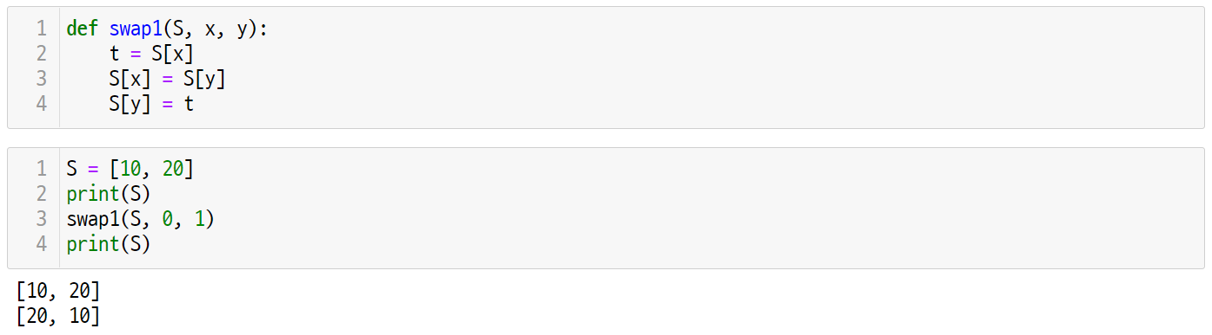

Let’s code
UNIT 27
1. Swap Operation
1.1. Swap: exchange the values of two elements
The two basic operations in the sorting algorithm are comparison and exchange operations. The exchange operation can be implemented as the following function.
5
5
6
6
7
7
8
8
Line 1~4
The swap() function takes a list S and the positions x and y of the list elements as input parameters.
Store the value of S[x] into a temporary variable t and store the value of S[y] into S[x].
The value of S[x] stored in the t variable as the temporary storage is stored in S[y].

Slide 53
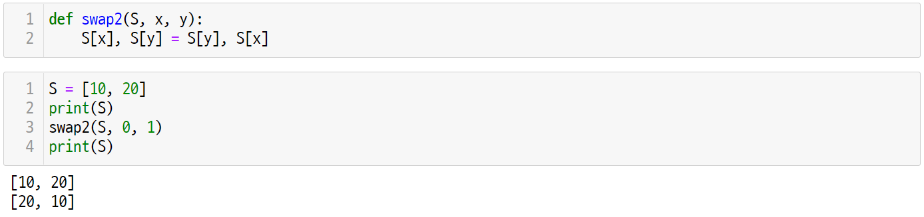
Let’s code
UNIT 27
1. Swap Operation
1.2. Swap in Python
In Python, you can store values in multiple variables at the same time, so you can exchange the values of two variables more simply as follows.
3
4
5
6
Line 1~2
Substitute the values of S[y] and S[x] into S[x] and S[y], respectively.
At this time, it should be noted that the two values can be exchanged because the value on the right is converted into a tuple and assigned to the value on the left.

Slide 54
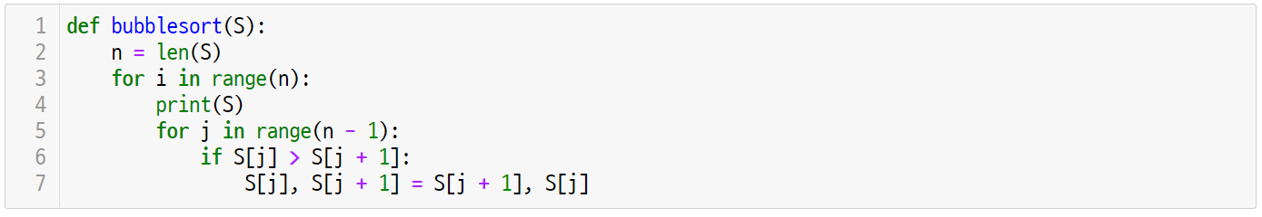
Let’s code
UNIT 27
2. Bubble Sort
2.1. Implementing bubble sort
Bubble sort is an algorithm that exchanges two adjacent elements by checking them as follows.
Line 3~7
For every i, the values of adjacent elements are compared for the element j to the right of i.
If two adjacent elements are out of order, the two values are swapped.

Slide 55
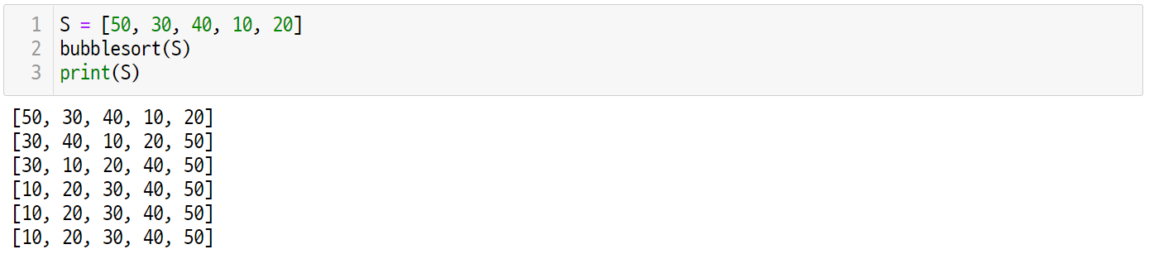
Let’s code
UNIT 27
2. Bubble Sort
2.2. Running bubble sort
Bubble sort is an algorithm that exchanges two adjacent elements by checking them as follows.
8
9
10
Line 4
To check the operation of bubble sort, the state of S is output every time the i-th loop is executed.

Slide 56
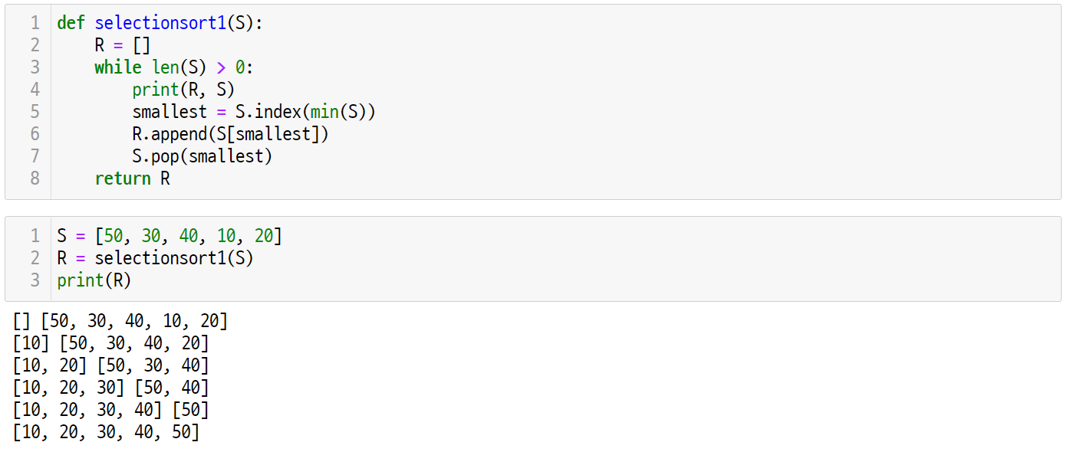
Let’s code
UNIT 27
3. Selection Sort
3.1. Implementing selection sort without swap
Selection sort is an algorithm that selects the smallest value from the list and adds it to the sorted list as follows.
Line 1~8
It takes an unsorted list S as an input parameter and returns a sorted list R.
Find the largest element in S, delete it, add the deleted element to R, and repeat until S becomes an empty list.

Slide 57
Let’s code
UNIT 27
3. Selection Sort
3.2. Running selection sort without swap
Check the operation of the selection sort algorithm. They are added to R in order of the smallest element in S.
9
10
11
Line 4
To check the operation of selection sort, the state of S is output whenever the while loop is executed.

Slide 58
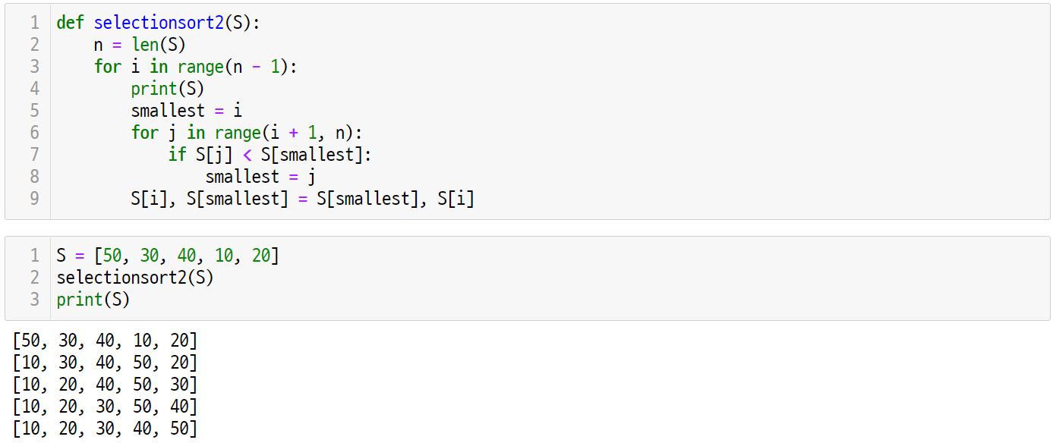
Let’s code
UNIT 27
3. Selection Sort
3.3. Implementing In-Place selection sort
In-Place sorting refers to a sorting algorithm that sorts through a swap operation without using additional memory. The selectionsort1() algorithm implemented earlier uses additional memory R, so it is not an in-place sort.
In order to implement the In-Place sorting algorithm for selection sort, implement it as follows using the swap operation as shown earlier.
Line 1~9
In Line 6-8, find the position of the smallest element after the i-th element.
In Line 9, the i-th element and the element of the smallest position are exchanged.
In the outside for-loop, i is repeated from the first element of the list to the last element.

Slide 59
Let’s code
UNIT 27
3. Selection Sort
3.4. Running In-Place selection sort
Check the operation of the selection sort algorithm. They are sorted in the order of the smallest element without using additional memory.
10
11
12
Line 4
To check the operation of selection sort, the state of S is output every time the i-th loop is executed.

Slide 60
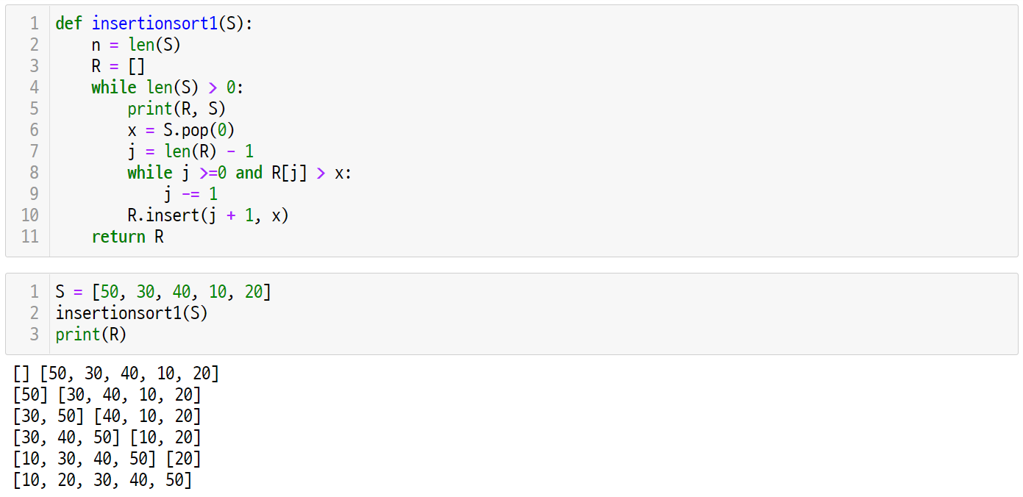
Let’s code
UNIT 27
4. Insertion Sort
4.1. Implementing insertion sort with additional memory
Insertion sort is a sorting algorithm that adds a new element to the correct position in the sorted list as follows.
Line 1~11
It takes an unsorted list S as an input parameter and returns a sorted list R.
We take elements from S one by one, move forward from the last element of R, and add them to the position where the element is to be inserted.

Slide 61
Let’s code
UNIT 27
4. Insertion Sort
4.2. Running insertion sort with additional memory
Check the operation of the insertion sort algorithm. Add elements of S to R in sorted order.
9
10
11
Line 5
In order to check the operation of insertion sort, the state of S is output whenever the while loop is executed.

Slide 62
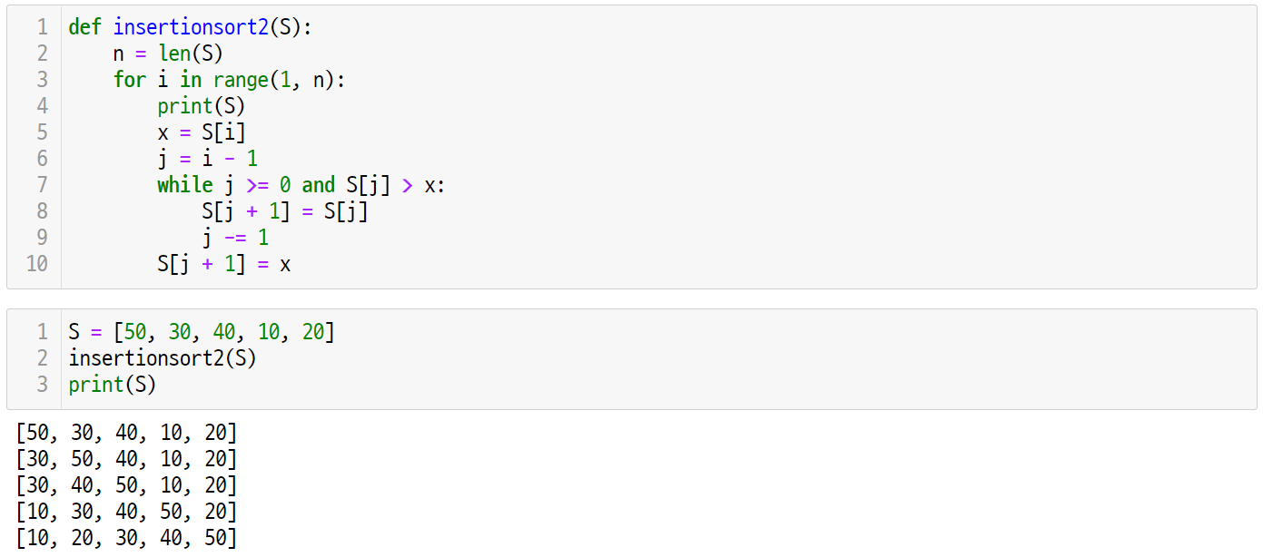
Let’s code
UNIT 27
4. Insertion Sort
4.3. Implementing In-Place insertion sort
In order to implement insertion sort as an in-Place sorting algorithm, it can be implemented while moving elements one by one, as shown earlier.
Line 1~10
In Line 5, the i-th element is temporarily stored in x.
In Line 6-9, decrease j while moving the element until it encounters an element greater than x, and then store x in the corresponding position.
In the outside for-loop, i is repeated from the first element of the list to the last element.

Slide 63
Let’s code
UNIT 27
4. Insertion Sort
4.4. Running In-Place insertion sort
Check the operation of the insertion sort algorithm. It places an element of S in it’s right position by insertion.
9
10
11
Line 4
In order to check the operation of insertion sort, the state of S is output every time the i-th for loop is executed.

Slide 64

Let’s code
UNIT 27
One More Step
What is the time complexity of the sorting algorithm?
The bubble sort algorithm executes a double nested for-loop, and the number of comparisons for each pass is N – 1, N – 2, N – 3, … , 0.
The number of comparisons in the bubble sort algorithm is T(N) = (N – 1) + (N - 2) + … + 1 = N(N-1)/2.
The time complexity of the bubble sort algorithm is O(N²).
Since selection sort executes a double for-loop like bubble sort, the time complexity is O(N²) for the same reason.
In the case of insertion sort, the number of comparisons differs between the worst case and the best case.
The best case is an already sorted array. In this case, the time complexity becomes O(N) because the insertion position can be found only by one comparison for each pass.
The worst case is an array sorted in reverse order. In this case, the time complexity is O(N²) as in bubble/selection sort, because the insertion position must be compared with all elements of the sorted list for each pass.

Slide 65
Unit 27.
Bubble, Selection, and Insertion Sort
Pop quiz

Slide 66
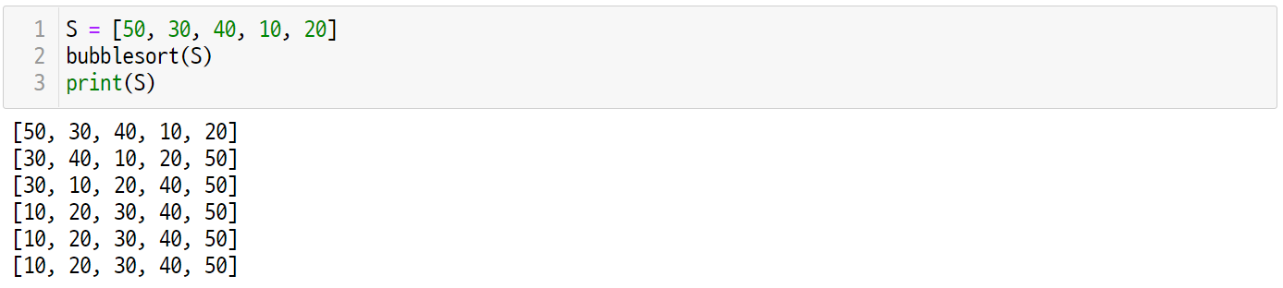
Pop quiz
UNIT 27
Q1.
How many swap operations were executed in the bubble sort process below?

Slide 67
Pop quiz
UNIT 27
Q2.
How many comparison operations were executed in the insertion sort process below?

Slide 68
Unit 27.
Bubble, Selection, and Insertion Sort
Pair programming

Slide 69
Pair programming
UNIT 27

Slide 70
Pair programming
UNIT 27

Slide 71
Pair programming
UNIT 27
Q1.
Given two words, write an algorithm that determines whether these two strings are anagrams.
An anagram is a word formed by rearranging the letters of a different word using all the original letters exactly once. (ex. “LISTEN” and “SILENT” are anagrams.)
L
I
S
T
E
N
S
I
L
E
N
T

Slide 72
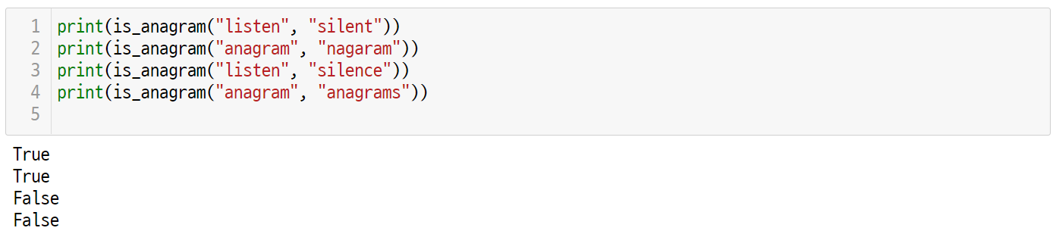
Pair programming
UNIT 27
Q2.
Using a sorting algorithm makes it easy to determine if it is an anagram or not.
Create a function that evaluates anagrams using Python's built-in sorted() function.
Modify the selection_sort2() function to create a function that determines anagrams.
Modify the insertion_sort2() function to create a function that determines the anagram.

Slide 73
Unit 28.
Merge Sort

Slide 74
Unit learning objective (1/3)
UNIT 28
Learning objectives
Understand merge sort algorithm and be able to solve sorting problems using merge sort.
Understand and be able to explain the difference between merge sort, bubble sort, selection sort, and insertion sort.
Understand and be able to explain the time complexity of merge sort.

Slide 75
Unit learning objective (2/3)
UNIT 28
Learning overview
Implement merge sort that divides the given unsorted list, sorts each, and merges them back together.
Implement a merge function that converts two sorted lists into one sorted list for merge sort.
Understand that merge sort algorithm is divide-and-conquer using recursive functions.
Concepts you will need to know from previous units
Using comparison operators to compare two numbers.
Dividing the given problem and call the recursive function recursively.
Applying Big O notation to analyze the time complexity of an algorithm.

Slide 76
Unit learning objective (3/3)
UNIT 28
Keywords
Sorting Problem
Merge Sort
Merge

Slide 77
Unit 28.
Merge Sort
Mission

Slide 78

Mission
UNIT 28
1. Real world problem
1.1 The problem of merging
In the previous unit, we studied the O(N²) sorting algorithms. Can we create a more efficient sorting algorithm than these.
Ex
Suppose you are given 4 blue and 4 green iron marbles as shown below. These iron marbles are the same shape and size but have different weights. However, if these iron marbles are arranged in ascending order of weight as shown below, how can the whole be sorted?
10
20
40
80
30
50
60
70
10
20
30
40
50
60
70
80

Slide 79
Mission
UNIT 28
2. Mission
2.1. Merging two sorted list
Use the balance scale. The balance scale can do the following operations:
Take the lightest marble from two barrels of iron marble and compare them.
The lighter of the two iron marbles can be placed in a new iron marble barrel.
Knowing that the two barrels already contain sorted marbles, we can compare the two marbles with the least weight in each of the two barrels and take a strategy to place them in a new barrel.
With this strategy, how many comparisons would it take to place all the marbles in sorted order by weight?
Sorted
Sorted
Sorted

Slide 80
Unit 28.
Merge Sort
Key concept

Slide 81
Key concept
UNIT 28
1. Merge Sort
1.1. An example of merge sort
Merge sort is a sorting algorithm that divides an unsorted list into two sublists. sorts them, and then merges them into a sorted list.
Ex
Suppose we want to sort a list arranged in the order of [27, 10, 12, 20, 25, 13, 15, 22] as follows.
27
10
12
20
25
13
15
22

Slide 82
Key concept
UNIT 28
1. Merge Sort
1.1. An example of merge sort
First, divide 8 elements by two to get 4 elements each. If this divides list is in a sorted state, you can merge the two divided lists in a sorted state again. We have to recursively sort the divided list.
27
10
12
20
25
13
15
22
27
10
12
20
25
13
15
22
merge
Sorted List

Slide 83
Key concept
UNIT 28
1. Merge Sort
1.1. An example of merge sort
An unsorted list divided into two can be divided into two and merged into a sorted list. Since the divided list is not sorted yet, the recursive call continues.
27
10
12
20
25
13
15
22
27
10
12
20
25
13
15
22
merge
merge
Sorted List
Sorted List

Slide 84
Key concept
UNIT 28
1. Merge Sort
1.1. An example of merge sort
dividing a two-element list results in a one-element list. In this case, since a list with one element is a sorted list, the lists can be merged again in a sorted state.
27
10
12
20
25
13
15
22
27
10
12
20
25
13
15
22
Sorted
List
Sorted
List
Sorted
List
Sorted
List
Sorted
List
Sorted
List
Sorted
List
Sorted
List

Slide 85
Key concept
UNIT 28
1. Merge Sort
1.1. An example of merge sort
Merging one-element lists creates a two-element ordered list.
27
10
12
20
25
13
15
22
merge
merge
merge
merge
10
27
12
20
13
25
15
22

Slide 86
Key concept
UNIT 28
1. Merge Sort
1.1. An example of merge sort
Merging two-element lists creates a four-element sorted list.
10
27
12
20
13
25
15
22
merge
merge
10
12
20
27
13
15
22
25
Sorted List
Sorted List

Slide 87
Key concept
UNIT 28
1. Merge Sort
1.1. An example of merge sort
Merging a four-element list creates an eight-element sorted list.
10
12
20
27
13
15
22
25
merge
10
12
13
15
20
22
25
27
Sorted List

Slide 88
Key concept
UNIT 28
1. Merge Sort
1.2. Merging two sorted lists
Find a method to merge two sorted lists into one sorted list. Use a balance scale.
10
12
20
27
13
15
22
25
Sorted List

Slide 89
Key concept
UNIT 28
1. Merge Sort
1.2. Merging two sorted lists
First, take the smallest element of the two sorted lists one by one and compare them. In this case, since 10 is less than 13, 10 is added to the sorted list first.
10
12
20
27
13
15
22
25
10
13
10

Slide 90
Key concept
UNIT 28
1. Merge Sort
1.2. Merging two sorted lists
Remove the element sent to the sorted list and compare the next element. Since 12 is less than 13, 12 is added to the sorted list.
12
20
27
13
15
22
25
12
13
10
12

Slide 91
Key concept
UNIT 28
1. Merge Sort
1.2. Merging two sorted lists
Remove the element sent to the sorted list and compare the next element. Since 20 is greater than 13, 13 is added to the sorted list.
20
27
13
15
22
25
20
13
10
12
13

Slide 92
Key concept
UNIT 28
1. Merge Sort
1.2. Merging two sorted lists
Remove the element sent to the sorted list and compare the next element. Since 15 is less than 20, 15 is added to the sorted list.
20
27
15
22
25
20
15
10
12
13
15

Slide 93
Key concept
UNIT 28
1. Merge Sort
1.2. Merging two sorted lists
Remove the element sent to the sorted list and compare the next element. Since 20 is less than 22, 20 is added to the sorted list.
20
27
22
25
20
22
10
12
13
15
20

Slide 94
Key concept
UNIT 28
1. Merge Sort
1.2. Merging two sorted lists
Remove the element sent to the sorted list and compare the next element. Since 22 is less than 27, 22 is added to the sorted list.
27
22
25
27
22
10
12
13
15
20
22

Slide 95
Key concept
UNIT 28
1. Merge Sort
1.2. Merging two sorted lists
Remove the element sent to the sorted list and compare the next element. Since 22 is less than 27, 22 is added to the sorted list.
27
25
27
25
10
12
13
15
20
22
25

Slide 96
Key concept
UNIT 28
1. Merge Sort
1.2. Merging two sorted lists
If one of the two lists is empty, all elements in the other list are added to the sorted list in order.
27
10
12
13
15
20
22
25
27

Slide 97
Unit 28.
Merge Sort
Let’s code

Slide 98
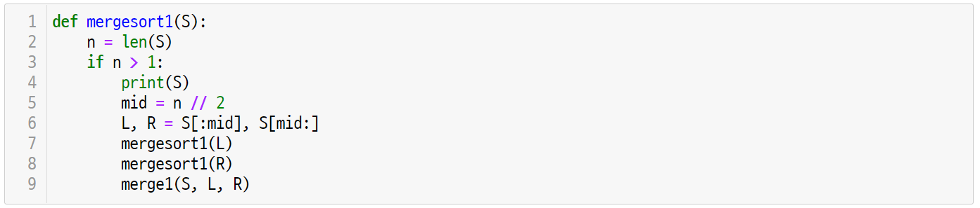
Let’s code
UNIT 28
1. Implementing Merge Sort with Additional Memory
1.1. Merge sort by the divide-and-conquer approach
A simple way to implement merge sort is to conquer a given list by dividing it into two lists. This algorithm design method is called divide-and-conquer, and we will study it again in Unit 31.
Line 1~3
Merge sort conquers a given S by dividing it into two lists if the size of S is greater than 1.
If the size of the given S is 1 or less, the sorting can be terminated because it has already been sorted.

Slide 99
Let’s code
UNIT 28
1. Implementing Merge Sort with Additional Memory
1.1. Merge sort by the divide-and-conquer approach
If the given size of S is greater than 1, it is divided into two lists, sorted into two lists, and merged into one list.
Line 5~8
To divide a given S into two, after finding the mid value, it is divided into two lists, L and R.
At this time, it is necessary to note that the list S is created as a separate list for L and R through slicing.
Separately created L and R sort separately through recursive calls.

Slide 100
Let’s code
UNIT 28
1. Implementing Merge Sort with Additional Memory
1.1. Merge sort by the divide-and-conquer approach
If L and R are sorted lists, we can merge these two lists into sorted S.
Line 9
Merge L and R to create a sorted list S.

Slide 101
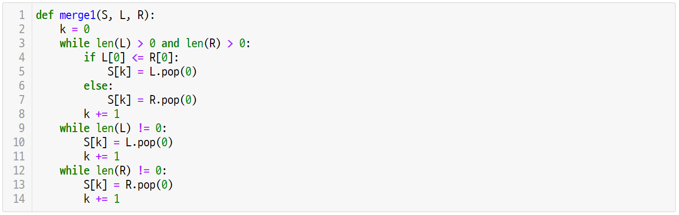
Let’s code
UNIT 28
1. Implementing Merge Sort with Additional Memory
1.2. Merge two sorted lists into a sorted list
The merge1() function creates a sorted list S by merging L and R, which are sorted lists, respectively.
Line 2~8
While increasing the index of k, the smaller of the first elements of L and R is stored as the k-th element of S.

Slide 102
Let’s code
UNIT 28
1. Implementing Merge Sort with Additional Memory
1.2. Merge two sorted lists into a sorted list
The merge1() function creates a sorted list S by merging L and R, which are sorted lists, respectively.
Line 9~11
When exiting the while-loop of Line 3-8, one of the two lists L and R has processed all elements.
If the length of L is non-zero, all remaining elements of L can be added to S.

Slide 103
Let’s code
UNIT 28
1. Implementing Merge Sort with Additional Memory
1.2. Merge two sorted lists into a sorted list
The merge1() function creates a sorted list S by merging L and R, which are sorted lists, respectively.
Line 12~14
If the length of the list R is non-zero, then all L is processed and only R is left unprocessed.
All the remaining elements of R need to be added to S.

Slide 104
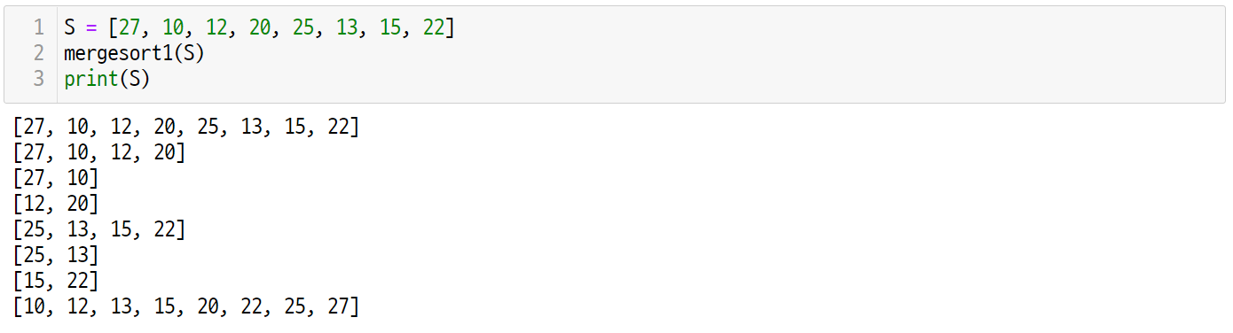
Let’s code
UNIT 28
1. Implementing Merge Sort with Additional Memory
1.3. Running merge sort
Once the example used earlier is applied to the mergesort1() function, the output is as follows.
Line 1~3
The S given by print(S) is printed on the 4th line of the mergesort1() function.
The S output from Line 3 is the sorted result after the mergesort1() function is executed.

Slide 105
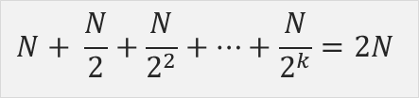
Let’s code
UNIT 28
One More Step
How much memory is additionally used by the mergesort1() function?
The mergesort1() function creates new lists L and R each time the function is called. If the size of these two lists is added, it becomes the same size as the S originally passed in the call.
Since the recursive call is called for L and R respectively, the size of the two lists at each recursive call is about half the size of the previous call. Therefore, the size of the additionally used list is as follows.
$$N+ \frac{N}{2}+\frac{N}{2^{2}}+⋯+\frac{N}{2^{k}}=2N$$
The mergesort1() function must use an additional memory of size 2N which is twice the size N of a given S.
This algorithm can be modified to use only N additional memory.

Slide 106
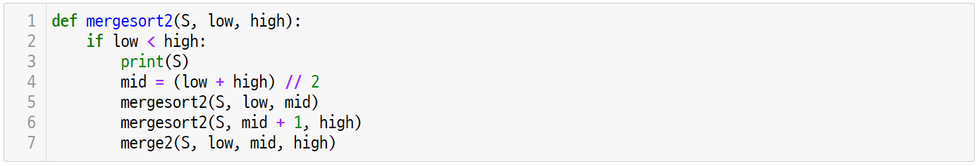
Let’s code
UNIT 28
2. Implementing Merge Sort More Efficiently
2.1. Enhanced merge sort
The mergesort2() sorts S by specifying the ranges of low and high instead of dividing S into L and R.
Line 1~3
For a given S, it receives the indices of low and high as input parameters.
A recursive call is made only if low is less than the high value, otherwise, the sort is terminated.

Slide 107
Let’s code
UNIT 28
2. Implementing Merge Sort More Efficiently
2.1. Enhanced merge sort
The mergesort2() sorts S by specifying the ranges of low and high instead of dividing S into L and R.
Line 4~7
In order to divide and conquer the elements in the low and high ranges, a recursive call is made based on mid.
The merge2() function merges two sorted elements into one based on mid.

Slide 108
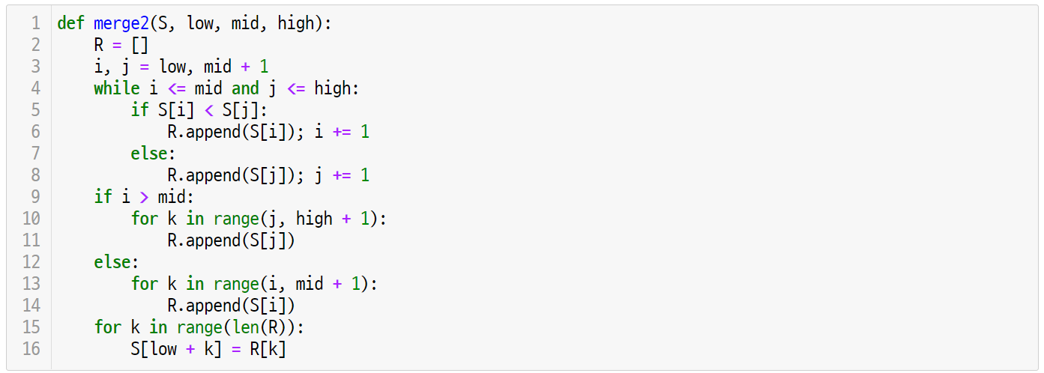
Let’s code
UNIT 28
2. Implementing Merge Sort More Efficiently
2.2. Merging two sorted list for enhanced merge sort
The merge2() function makes elements sorted from left to right into low and high ranges based on mid.
Line 2~8
Add the sorted elements to a new list called R, starting at i and j at low and mid+1, respectively.
It should be noted that the elements before mid and after mid + 1 are sorted elements, respectively.

Slide 109
Let’s code
UNIT 28
2. Implementing Merge Sort More Efficiently
2.2. Merging two sorted list for enhanced merge sort
The merge2() function makes elements sorted from left to right into low and high ranges based on mid.
Line 9~11
When exiting the while-loop of Line 3-8, either i will be greater than mid or j will be greater than high, depending on the condition of Line 4.
If i is greater than mid, the remaining elements must be added to R until the index of j becomes high.

Slide 110
Let’s code
UNIT 28
2. Implementing Merge Sort More Efficiently
2.2. Merging two sorted list for enhanced merge sort
The merge2() function makes elements sorted from left to right into low and high ranges based on mid.
Line 12~14
When exiting the while-loop of Line 3-8, either i will be greater than mid or j will be greater than high, depending on the condition of Line 4.
If i is not greater than mid, the remaining elements must be added to R until the index of i becomes mid.

Slide 111
Let’s code
UNIT 28
2. Implementing Merge Sort More Efficiently
2.2. Merging two sorted list for enhanced merge sort
The merge2() function makes elements sorted from left to right into low and high ranges based on mid.
Line 15~16
In line 15, a single sorted list from low to high is stored in the R list.
All elements from low to high of S are copied to the elements of R list.

Slide 112
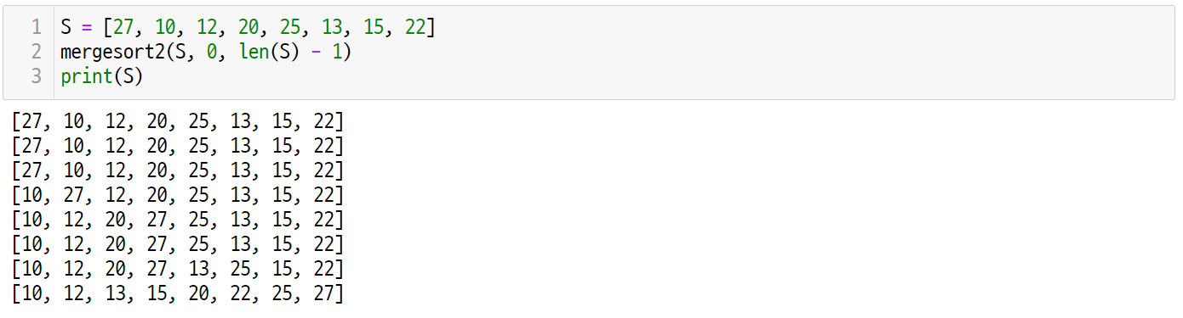
Let’s code
UNIT 28
2. Implementing Merge Sort More Efficiently
2.3. Running enhanced merge sort
Once the example used earlier is applied to the mergesort2() function, the output is as follows.
Line 1~3
The S given by print(S) is printed on the 3rd line of the mergesort2() function.
The S output from Line 3 is the sorted result after the mergesort2() function is executed.
It should be noted that the size of S does not change, unlike the output of the mergesort1() function.

Slide 113
Unit 28.
Merge Sort
Pop quiz

Slide 114
Pop quiz
UNIT 28
Q1.
How many times was the merge2() function executed in the merge sort process below?

Slide 115
Unit 28.
Merge Sort
Pair programming

Slide 116
Pair programming
UNIT 28

Slide 117
Pair programming
UNIT 28

Slide 118
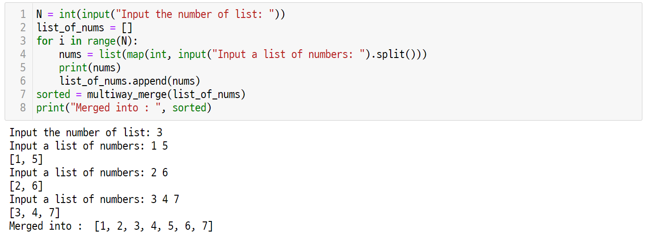
Pair programming
UNIT 28
Q1.
Given N sorted lists as input, write a program that merges them into a sorted list.

Slide 119
Unit 29.
Quick Sort

Slide 120
Unit learning objective (1/3)
UNIT 29
Learning objectives
Understand the quick sort algorithm and be able to solve sorting problems using quick sort.
Understand and be able to explain the difference between quick sort and merge sort.
Understand and be able to explain the time complexity of quicksort.

Slide 121
Unit learning objective (2/3)
UNIT 29
Learning overview
Implement a quick sort that divides a given unsorted list based on the pivot and sorts them individually.
Implement a partition function that divides an unsorted list based on the pivot for quick sorting.
Understand that quick sort is also a divide-and-conquer method using a recursive function like the merge sort algorithm.
Concepts you will need to know from previous units
Using comparison operators to compare two numbers.
Dividing the given problem and call the recursive function recursively.
Applying Big O notation to analyze the time complexity of an algorithm.

Slide 122
Unit learning objective (3/3)
UNIT 29
Keywords
Sorting Problem
Quick Sort
Pivot and Partitioning

Slide 123
Unit 29.
Quick Sort
Mission

Slide 124

Mission
UNIT 29
1. Real world problem
1.1. In-Place sorting
In the previous unit, we studied the merge sort algorithm. However, in order to use merge sort, we had to use separate memory space of the same size as the given list. Can we design an efficient sorting algorithm without extra memory space?
Ex
Suppose you are given 7 iron marbles as shown below. These iron marbles are the same shape and size but have different weights. By just swapping these iron marbles, can things lighter than red marbles be sent to the left and things heavier than red marbles to the right?
40
50
10
70
60
30
20
20
10
30
40
50
70
60

Slide 125
Mission
UNIT 29
2. Mission
2.1. Partitioning with pivot
Use the balance scale. The balance scale can do the following operations:
You can compare the weights by taking out two marbles from a barrel of iron marbles.
The positions of the two iron marbles can be swapped.
We have a reference red marble, so we can find a marble lighter and one heavier than the red marble and swap them.
With this strategy, how many comparisons do all the marbles need to be placed in sorted order by weight?

Slide 126
Mission
UNIT 29
pivot
lighter than pivot
pivot
heavier than pivot

Slide 127
Unit 29.
Quick Sort
Key concept

Slide 128
Key concept
UNIT 29
1. Quick Sort
1.1. An example of quick sort
Quick sort is a sorting algorithm that recursively sorts an unsorted list by dividing it into two sublists, according to the value of pivot.
Ex
Suppose we want to sort a list arranged in the order [15, 10, 12, 20, 25, 13, 22] as follows.
15
10
12
20
25
13
22

Slide 129
Key concept
UNIT 29
1. Quick Sort
1.1. An example of quick sort
First, the first element 15 is set as the pivot. Elements smaller than the pivot are divided to the left of the pivot, and elements larger than the pivot are divided to the right of the pivot.
pivot
15
10
12
20
25
13
22
15
13
10
12
25
20
22

Slide 130
Key concept
UNIT 29
1. Quick Sort
1.1. An example of quick sort
Divide by pivoting the first element in each divided list.
Next, divide the sublists with a new pivot in each divided sublist respectively.
pivot
pivot
13
10
12
15
25
20
22
13
25
12
10
22
20

Slide 131
Key concept
UNIT 29
1. Quick Sort
1.1. An example of quick sort
Divide by pivoting the first element in each divided list.
Next, divide the sublists with a new pivot in each divided sublist respectively.
pivot
pivot
12
10
13
15
22
20
25
12
22
10
20

Slide 132
Key concept
UNIT 29
1. Quick Sort
1.1. An example of quick sort
If there is only one element, the recursive call is terminated because it is sorted. At this time, the entire list is sorted.
pivot
pivot
10
12
13
15
20
22
25
10
12
13
15
20
22
25
Sorted List

Slide 133
Key concept
UNIT 29
1. Quick Sort
1.2. Partitioning with pivot
Find a method to divide left and right based on the pivot without using separate storage space. Use the balance scale.
15
10
12
20
25
13
22

Slide 134
Key concept
UNIT 29
1. Quick Sort
1.2. Partitioning with pivot
First, find a value greater than the pivot from left to right in the set of elements excluding the pivot. Since 10 is less than 15, it moves to the next element.
15
10
12
20
25
13
22
15
10

Slide 135
Key concept
UNIT 29
1. Quick Sort
1.2. Partitioning with pivot
Since 12 is less than 15, it moves to the next element.
15
10
12
20
25
13
22
15
12

Slide 136
Key concept
UNIT 29
1. Quick Sort
1.2. Partitioning with pivot
Since 20 is greater than 15, 20 is the first element in the list that is greater than the pivot.
15
10
12
20
25
13
22
15
20
20

Slide 137
Key concept
UNIT 29
1. Quick Sort
1.2. Partitioning with pivot
Next, find the first element less than the pivot from right to left. Since 22 is greater than 15, it moves to the next element.
15
10
12
20
25
13
22
15
22
20

Slide 138
Key concept
UNIT 29
1. Quick Sort
1.2. Partitioning with pivot
Since 13 is less than 15, 13 is the last element less than 15.
15
10
12
20
25
13
22
15
13
20
13
larger than
pivot
smaller than
pivot

Slide 139
Key concept
UNIT 29
1. Quick Sort
1.2. Partitioning with pivot
The first element greater than the pivot and the last element less than the pivot are swapped. By repeating this process, elements smaller than the pivot and elements larger than the pivot are divided into two partitions.
15
10
12
13
25
20
22
swap
20
13
larger than
pivot
smaller than
pivot

Slide 140
Key concept
UNIT 29
1. Quick Sort
1.2. Partitioning with pivot
In a two-partitioned list, when an element at a pivot position and a pivot item are exchanged with each other, the pivot is placed at the pivot position, elements smaller than the pivot are placed on the left, and elements larger than the pivot are placed on the right.
pivot position
15
10
12
13
25
20
22
swap
13
10
12
15
25
20
22
smaller than pivot
larger than pivot

Slide 141
Key concept
UNIT 29
1. Quick Sort
1.3. Choosing a pivot
Previously, we used the strategy of pivoting to select the first item in the list. What would happen if we used this strategy on an already sorted list like this:
10
12
13
15
20
22
25

Slide 142
Key concept
UNIT 29
1. Quick Sort
1.3. Choosing a pivot
Since each time the first item in the list is the smallest element, the partition() function cannot divide. We have to divide N times as follows.
pivot
10
12
13
15
20
22
25
10
12
13
15
20
22
25
10
12
13
15
20
22
25
10
12
13
15
20
22
25
10
12
13
15
20
22
25
10
12
13
15
20
22
25
10
12
13
15
20
22
25

Slide 143
Key concept
UNIT 29
1. Quick Sort
1.3. Choosing a pivot
What would happen if we set the pivot to an arbitrary element? In the worst case, the sorted order of elements may be selected, but the probability of such a case is very unlikely, so on average, it has an expected value of O(NlogN).

Slide 144
Unit 29.
Quick Sort
Let’s code

Slide 145
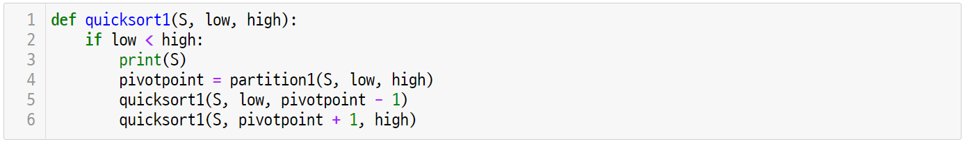
Let’s code
UNIT 29
1. Implementing Quick Sort with First Pivot
1.1. Quick sort with the divide-and-conquer approach
Quick sort uses a divide-and-conquer strategy like merge sort. The difference from merge sort is that since it divides into two lists based on the pivot, the sizes of the two lists may be different.
Line 1~3
Quick sort sorts the elements from low to high for a given S.
If low is equal to or less than high, sorting can be terminated because it is in the sorted state.

Slide 146
Let’s code
UNIT 29
1. Implementing Quick Sort with First Pivot
1.1. Quick sort with the divide-and-conquer approach
According to the pivot, the partition1() function divides the elements of S into elements smaller than the pivot and elements larger than the pivot. These two divided lists are sorted through a recursive call.
Line 4~6
pivotpoint returns the position of the pivot in the partition1() function.
Elements smaller than the pivot are placed to the left of the pivotpoint, and elements larger than the pivot are placed to the right of the pivot point.
The left and right elements are sorted based on the pivotpoint, respectively.

Slide 147
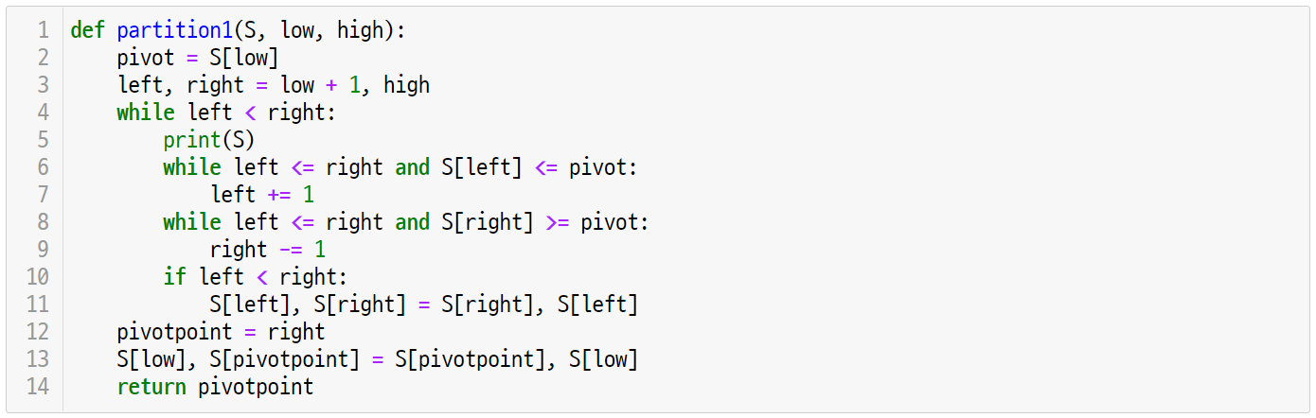
Let’s code
UNIT 29
1. Implementing Quick Sort with First Pivot
1.2. Partitioning with the first pivot
The partition1() function divides the elements from low to high in a given S based on the pivot. Assume that the pivot strategy is to select the first element of the given elements.
Line 1~2
The partition1() function takes S, low, and high as input parameters.
The first element in the given range S[low] is set as the pivot.

Slide 148
Let’s code
UNIT 29
1. Implementing Quick Sort with First Pivot
1.2. Partitioning with the first pivot
The partitioning operation selects a strategy to exchange elements in the range of S by comparing them at the left and right ends, respectively.
Line 3~11
Among the elements excluding the pivot, left and right are selected as the leftmost and rightmost elements.
Find the first element from the left that is greater than the pivot, and the first element from the right that is less than the pivot.
Swap the left and right elements.

Slide 149
Let’s code
UNIT 29
1. Implementing Quick Sort with First Pivot
1.2. Partitioning with the first pivot
When the exchange operation is finished, the first element selected by the pivot is moved to the center position.
Line 12-14
In Line 3-11, when the exchange operation is completed, the element S[pivotpoint] becomes the last element of the elements smaller than the pivot element.
If the pivot element in the low position and the element in the pivotpoint position are exchanged with each other, the partitioning operation is completed.

Slide 150
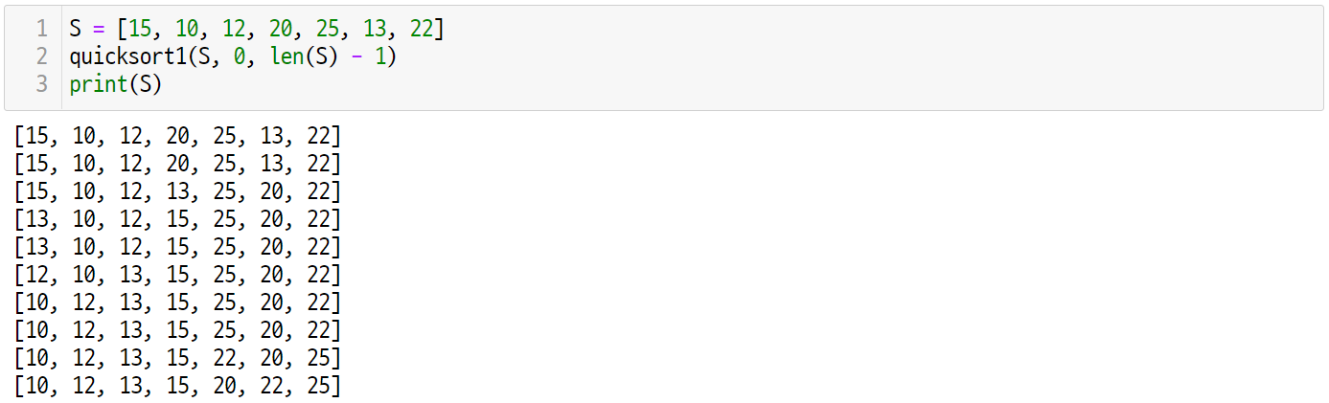
Let’s code
UNIT 29
1. Implementing Quick Sort with First Pivot
1.3. Running quick sort
When the quick sort algorithm implemented earlier is executed, the quick sort is performed through the following process.

Slide 151
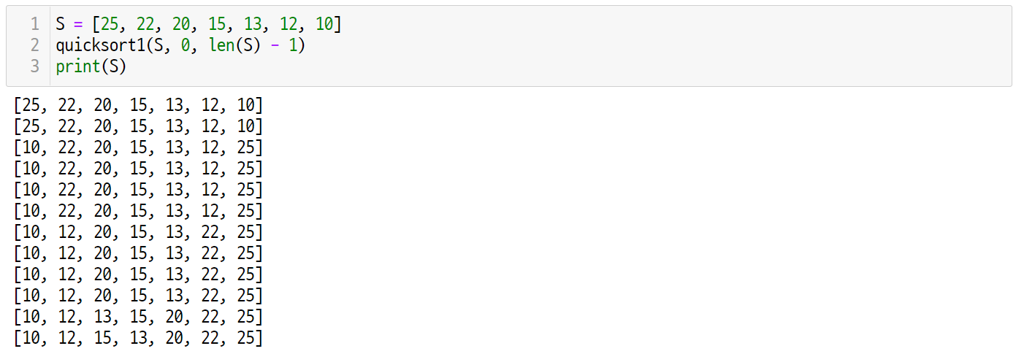
Let’s code
UNIT 29
1. Implementing Quick Sort with First Pivot
1.3. Running quick sort
The worst case of quick sort is when the given S is sorted in descending order. In this case, it can be confirmed that exactly N-1 elements are divided at each recursive call.

Slide 152
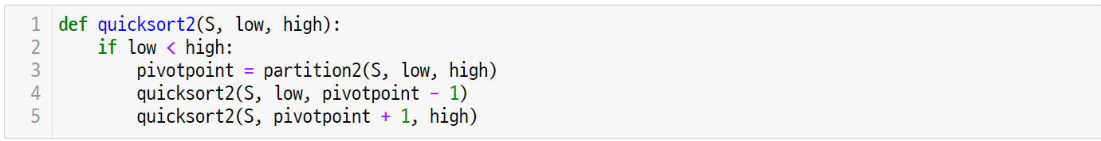
Let’s code
UNIT 29
2. Implementing Quick Sort with Randomized Pivot
2.1. Quick sort with randomized pivot
The quicksort1() algorithm selects the first element of the list as the pivot. The quicksort2() algorithm selects a random element as a pivot. Pivot selection is implemented in the partition2() function.

Slide 153
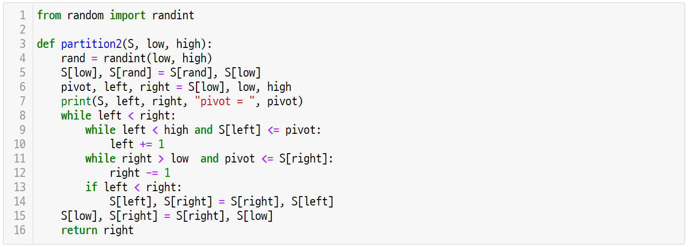
Let’s code
UNIT 29
2. Implementing Quick Sort with Randomized Pivot
2.2. Choosing a random pivot
The partition2() function selects a random element from the given element of S as a pivot.
Line 4~6
A random position within the given low and high range is set as the rand value.
When S[low] and S[rand] are exchanged, the first element is changed to a random element.

Slide 154
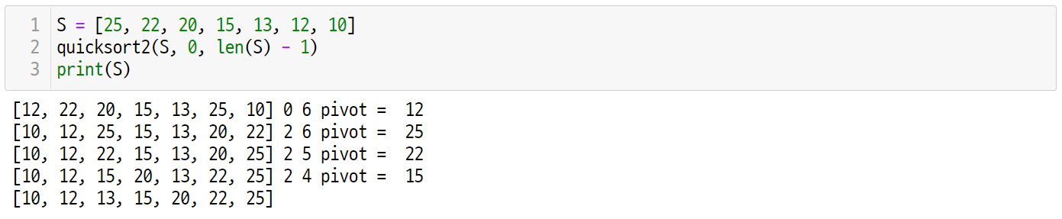
Let’s code
UNIT 29
2. Implementing Quick Sort with Randomized Pivot
2.3. Running quick sort with randomized pivot
It should be noted that the quicksort2() algorithm is not the worst case even for input cases sorted in descending order, unlike the quicksort1() algorithm.

Slide 155
Unit 29.
Quick Sort
Pop quiz

Slide 156
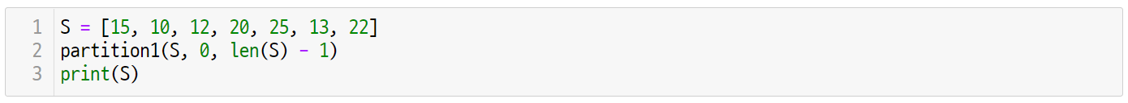
Pop quiz
UNIT 29
Q1.
Given the list below, write the output after executing the partition1() function.

Slide 157
Unit 29.
Quick Sort
Pair programming

Slide 158
Pair programming
UNIT 29

Slide 159
Pair programming
UNIT 29

Slide 160
Pair programming
UNIT 29
Q1.
Write an algorithm that finds the Kth largest element, given N unordered elements.
After solving the problem with the above two methods, analyze which algorithm is more efficient.
You can return the Kth element after using the sort function.
You can use the partition() function to make a recursive call until the pivot is the Kth element.

Slide 161

End of
Document
Samsung Innovation Campus

